Slide 1
Printed Circuit Board Design and Fabrication Techniques for the EagleSat CubeSat
Lisa Ferguson
Dr. Gary Yale
Arizona Space Grant Symposium
April 16, 2016

Slide 2
Overview
Design and fabrication techniques for space-ready custom printed circuit boards
Current research
  Design iteration management
  Fabrication considerations
  Engineering Model
  Space flight hardware

Slide 3
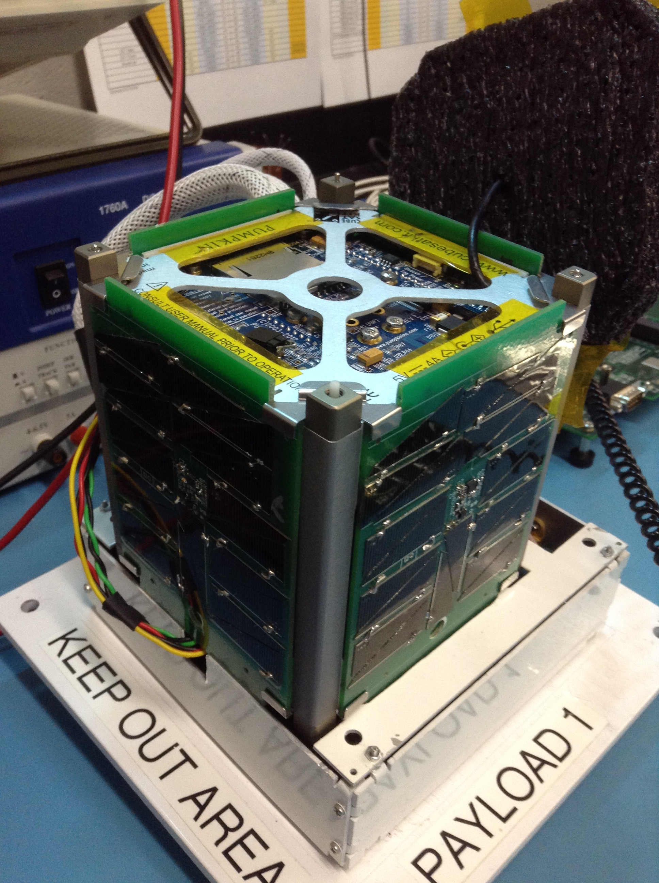
Design Process
Schematic
Board Layout
Paper Model
Functional Prototype
Flight Hardware
EagleSat-1 Functional Prototype

Slide 4
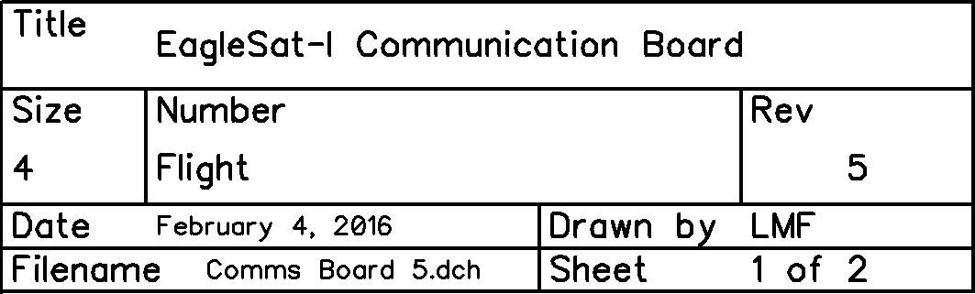
Revision Management
Revision block attached to all schematics and board layouts
All schematics and board layouts created in Diptrace

Slide 5
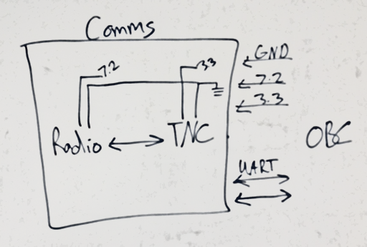
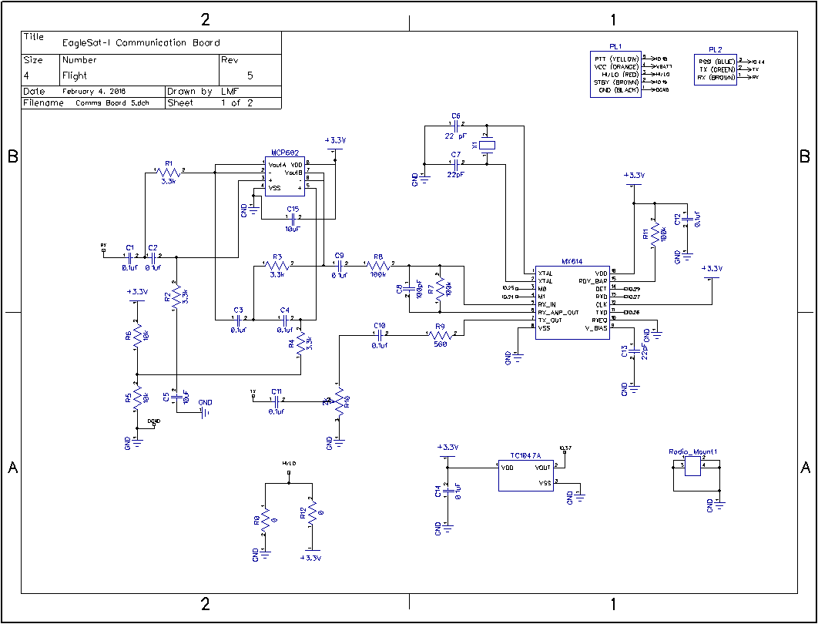
Schematic
Iterative Process
Team & Faculty Collaboration
Many proto-schematics before official revision
Schematics used for verification of board layout
Proto-Schematic vs Schematic Revision

Slide 6
Board Layout
Digital mockup of physical hardware
Layout Considerations
  Center of Mass
  Fabrication Process
  Component Accessibility
  Full System Integration
Board layout revisions as schematics evolve

Slide 7
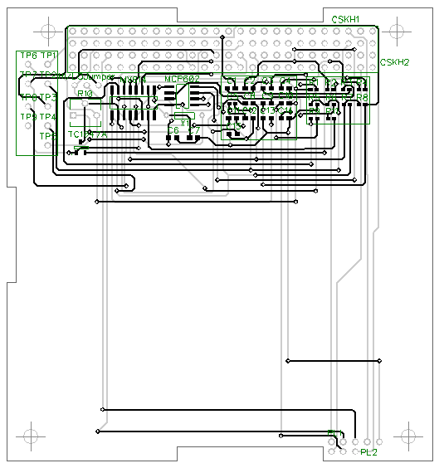
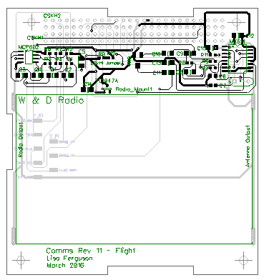
Board Layout
Communications Subsystem
Revision 1
Revision 11

Slide 8
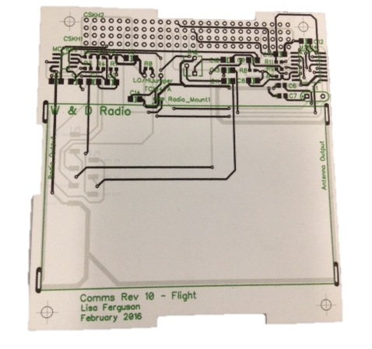
Paper Sizing Model
1:1 Scale Model
Printed on Cardstock
Cut to match dimensions
Use:
  Part Sizing
  Full System Visualization
  Modeling and Demonstration
Communication Board
Paper Model

Slide 9
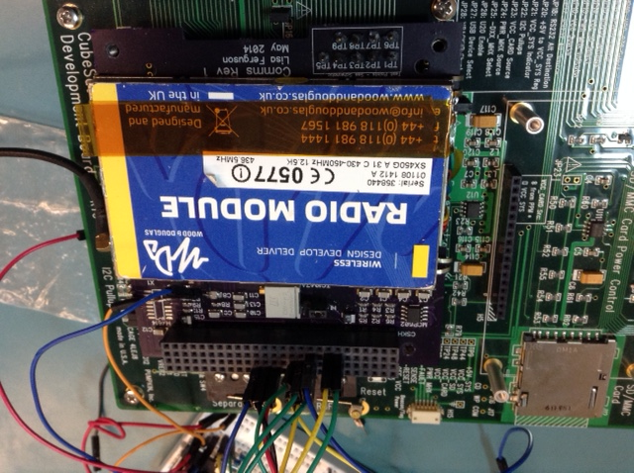
Engineering Model
Professionally Fabricated PCB
Follow space hardware assembly techniques
Considerations:
  Shock & Vibration
  Complete Pad Connectivity
  Solder Joint Sterility
Communications Functionality Prototype

Slide 10
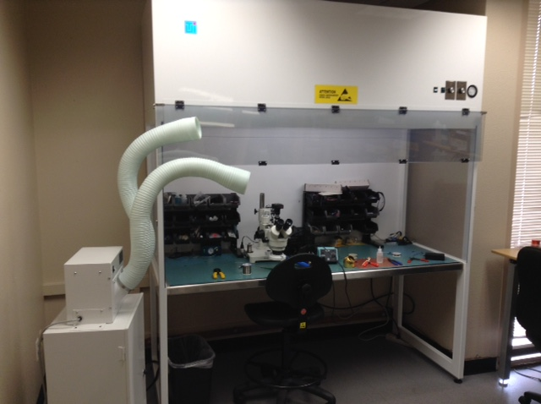
Space Hardware Fabrication
Class 10,000 Positive Pressure Laminar Flow Hood
  Ionization for ESD dissipation
Soldering Microscope
“Build a little, Test a little”
Isopropyl Alcohol Sanitation
Thermal Bake-out
Space Hardware Fabrication Station

Slide 11
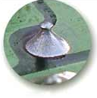
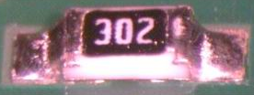
Correct Soldering
Smooth, shiny surface
Gentle wetting angle
No icicling or cold joint fractures
Achieved through proper temperature for appropriate duration
Ideal Through Hole
Solder Joint
Ideal Surface Mount
Solder Joint

Slide 12
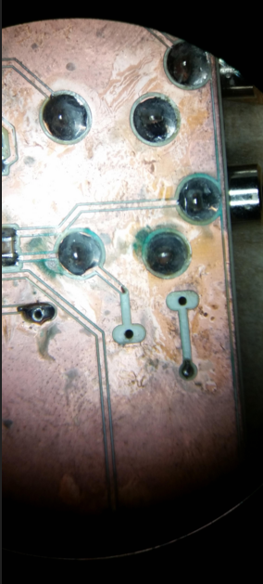
Incorrect Soldering
Copper Oxidization
Mold Growth
Incomplete Through-Hole Solder Joint
Pad Shorting

Slide 13
Space Flight Hardware
Professionally fabricated PCBs
Complete bill of material ordered
Two copies of each subsystem populated
  Earth Model
  Space Flight Model
Handoff to NASA for pre-flight testing

Slide 14
Acknowledgements
Dr. Gary Yale
Jim Weber
EagleSat Program
Arizona Space Grant Consortium

Slide 15
Questions
Thank You for Listening

